Slide 1
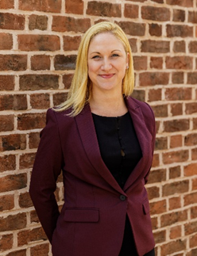
Future-Proofing Your Holiday Park Business
Proactive Estate Planning
Heather Lally LLB (Hons) TEP – Partner

Slide 2
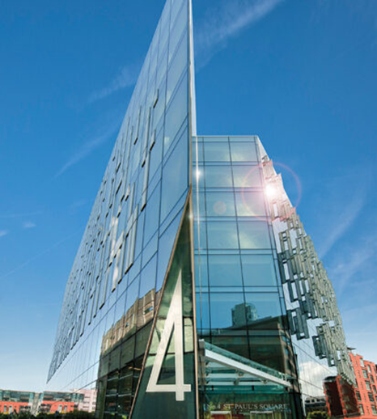
Established 2008
Offices – Chester and Liverpool
Medium sized law firm – 70 plus work force
Legal 500 and Chambers – High Net Worth
Full service law firm
Society for Trust and Estate Practitioners (STEP) Former Chair and vice Chair of STEP Cheshire Committee
Association of Lifetime Lawyers (ALL)
(Formerly Solicitors for the Elderly)
Member of the Agricultural Law Association (ALA)
Member of the Country Land and Business Association (CLA)
Cheshire Later Life Hub - One of Founding Members
19 years Post Qualification experience

Slide 3
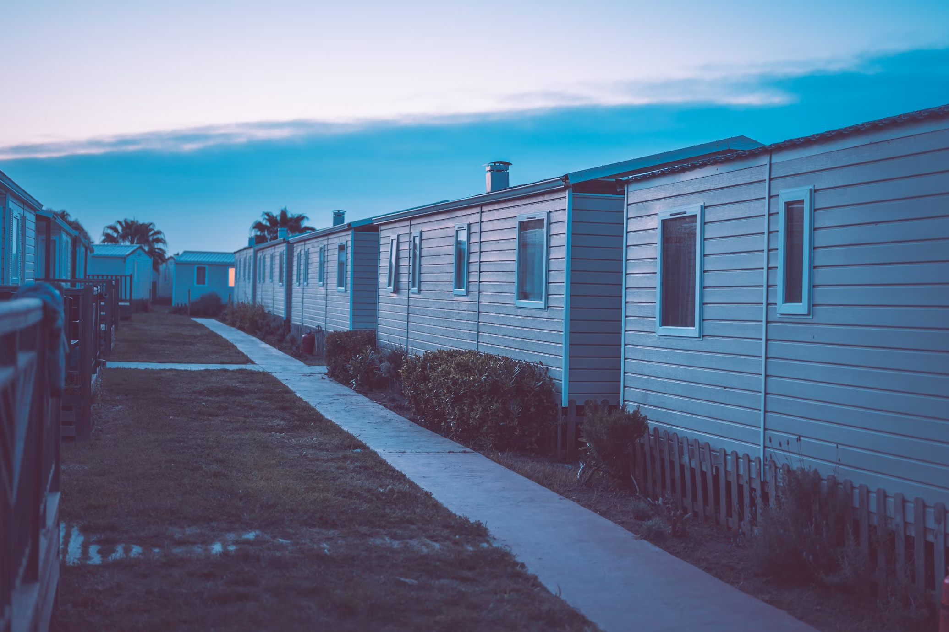
Planning for the ideals and the unknowns
Estate review
Inheritance Tax / Capital Gains Tax
Considering lifetime gifts
Trusts
Will options / asset protection
Lasting Powers of Attorney

Slide 4
Estate Planning
Health capacity reading signing
Where to begin?
Claims
Wishes
Family Tree
Relationships
Disability
Inheritance Tax / Capital Gains Tax
Assets and liabilities
Solicitor
Banker
Gifts
Valuer / Surveyor
Property / Land ownership
Accountant
Domicile
Financial Adviser
Care
Business Assets
Foreign Property
Pensions

Slide 5
Case Study
Main Residence (England) £600,000
Land £300,000
Cash, savings and
Investments £600,000
Cars £20,000
Jewellery £10,000
Life insurance policy £100,000
(pays out on first death)
Pension Death Benefit £200,000
(not written in Trust)
Company 1 Ltd £1,000,000
Partnership 1 £400,000 £3,230,000
No children
No children

Slide 6
Inheritance Tax (IHT) Allowances
Nil Rate Band (NRB) £325,000
Nil Rate Band £325,000
£650,000
Spousal Exemption
If conditions are met
Residence Nil Rate Band (RNRB) £175,000
Residence Nil Rate Band (RNRB) £175,000
£350,000
Reduced by £1 for every £2 over £2m
Maximum total £1,000,000
Second Death £3,230,000
Less - £650,000
£2,580,000 x 40% IHT
= £1,032,000 potential IHT
Main Residence £600,000
Land £300,000
Cash, savings and
Investments £600,000
Cars £20,000
Jewellery £10,000
£1,530,000
Life insurance policy £100,000
(pays out on first death)
Pension Death Benefit £200,000
(not written in Trust)
Company 1 Ltd £1,000,000
(No Business Relief)
Partnership 1
(No Business Relief) £400,000 £3,230,000

Slide 7
Business Relief (BR)
S105 Inheritance Tax Act (IHTA) 1984 – Relevant business property
Ownership Period – 2 Years
A Business or an interest in a business | 100%
Unquoted shares, including shares listed on AIM | 100%
Unquoted securities which on their own or combined with other unquoted shares or securities give control of an unquoted company | 100%
Quoted shares which give control of the company | 50%
Land or buildings, machinery or plant used wholly or mainly for the purposes of the business carried on by a company or partnership | 50%
Land or buildings, machinery or plant available under a life interest and used in a business carried on by the beneficiary | 50%
Owner managed, business – Partnership or Company
Shares in an unlisted trading Company
Listed company
Land buildings or machinery used in business (held personally) or by Company if Company had control
Regarded as Trading
Farming , Woodland Management, Sporting, shooting and fishing

Slide 8
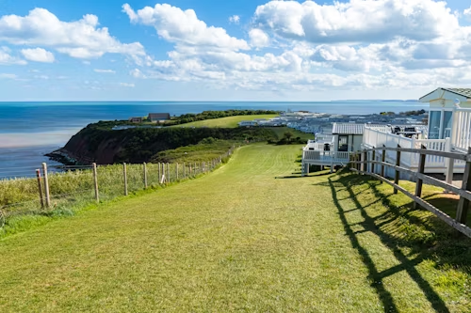
Non–qualifying business
Not carried on for gain – not for profit / not on a commercial basis
Subject to a contract for sale or being wound up
Mainly deals with securities, stocks or shares, land or
buildings or in making or holding investments
Excepted Assets
Not being used wholly/mainly for business purposes throughout 2 years before transfer on death or in lifetime; nor
Not required for future use in the business; (cash) – Potential loss of all Business Relief
unless sale to a company that will carry on the business and the estate will be paid mainly in shares of that company or if being wound up this is part of the process to allow the business of the company to continue.
Investment income only
Property letting business
Property dealing business
Serviced office business
Borderline (depends on nature of services provided)
Holiday business
Property development
Various other land related activities

Slide 9
Main Residence £600,000
Land £300,000
Cash, savings and
Investments £600,000
Cars £20,000
Jewellery £10,000
£1,530,000
Company 1 Ltd £1,000,000
Business relief 100%
Partnership 1
Business Relief 100% £400,000 £2,930,000
Life insurance policy £100,000
Pension Death Benefit £200,000
(both now re-directed via nominations or Trust)
Revised Inheritance Tax (IHT) calculation
Second Death – £1,530,000
Less £650,000
£880,000 x 40% IHT
= £352,000 potential IHT
Saving of £560,000 if 100% Business Relief applies
Saving of £120,000 IHT
Total Saving of £680,000 IHT

Slide 10
Estate Planning Options
Cash, savings and Investments - £600,000
Is there sufficient income from business assets?
Business Relief Portfolios – AIM - 100%
Gifts
- Charity
- Personal Allowance £3,000 per year / carry forward one year if unused
- Wedding Gifts (£5,000 child / £2,500 grandchild & great grandchild /
£1000 other person)
- Small gifts £250 different beneficiaries
- Normal expenditure out of income - regular pattern and records
- Gifting Schedules - 7 years – Individual = Potentially Exempt Transfers (PET) – Taper Relief
Trusts – lifetime discretionary trusts / discounted gift trusts – chargeable transfer
Family Investment Company

Slide 11
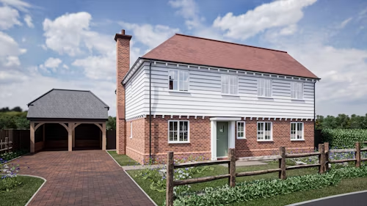
Land - £300,000
Is it used in the Business, if not could it be?
Any Agricultural Relief? If not could it be changed?
How is it held?
Sole name / Joint Tenants / Tenants in common
Personal names used in Business – 50% Business Relief
If held by the Partnership / Company – potentially 100%
Land Capital Account – Partnership Asset – cannot pass by Will
Disposal of Land to Partnership / Company - potential Capital Cains Tax /SDLT
Main Residence - £600,000
How is it held?
Sole name / Joint Tenants / Tenants in common
Is there an office in the Main residence?

Slide 12
Capital Gains Tax (CGT)
2024/2025 – Capital gains tax free allowance
£3,000 individuals / Personal Representatives / Trustees for disabled people
£1,500 Trusts (other trusts)
Capital Gain or Loss
Acquisition costs and enhancing the asset
Incidental costs of buying and selling inc. Stamp Duty Land Tax, Legal fees, Agents fees
Capital losses current year and brought forward / surplus trading losses
Available tax reliefs (Business Asset Disposal Relief / Investors Relief / Seed Enterprise Investment Scheme
SEIS / Enterprise Investment Scheme EIS)
Rates of Tax
Individuals (not including residential property gains and carried interest Gain | 10% & 20%
Individuals for residential property gains carried interest gains | 18% & 24% 28%
Trustees (not including residential property gains) | 20%
Trustees for residential property gains | 24%
Personal Representatives of someone who has dies (not including residential property gains and caried interest gains) | 20%
Personal Representatives of someone who has died residential property gains carried interest gains | 24% 28%
Gains for qualifying Business Asset Disposal Relief (formerly Entrepreneurs Relief) For shares – employee or office holder / main activities trading business (not investment business) | 10%
Non- Residential property or land
Commercial property
Agricultural land
Forests
Any other land or property which is not used as residence
Business Asset Disposal Relief
Apply at least 2 years up to the date you sell your business (or shares)
Sole Trader or a Business Partner Owned business at least 2 years
Same if closing business but you must dispose of your business within 3 years of qualifying for relief

Slide 13
Hold Over Relief on gifts
A Gift to an individual is a PET.
Gift hold over – give away business assets
The person you give them to pays the CGT when they sell them
Sole trader or business Partner or have at least 5% of voting rights in a company (your personal company)
Use the assets in your business or personal company
(usually get partial relief is you used the assets only partly for your business)
Give away shares (main activities Trading / not investment only business)
Not listed on any recognised stock exchange
Your personal company
Main Residence £600,000
Land £0.00
Gifted to Partnership £300,000
Cash, savings and
Investments £370,000
Gifted £230,000
Cars £20,000
Jewellery £10,000
£1,0000,000
Company Ltd £600,000
Business relief 100%
Gifted £400,000
Partnership
Business Relief 100% inc. Land £400,000
Gifted £300,000 £2,000,000
Life insurance policy £100,000
Pension Death Benefit £200,000
(re-directed via nominations or Trust)
Gift of land to company no CGT but company pays stamp duty on market value. Company can then issue you with shares and cost of the property becomes market value at the time of the gift. Immediately chargeable transfer for IHT.
Transfer to Co. Ltd you sell the property to Co. Ltd co for an amount which the Company owes you – Director’s loan.
Revised Inheritance Tax (IHT) calculation
Assuming survival for 7 years & gifted shares in the business remain as shares and qualify for BR
Second Death – £1,000,000
Less - £650,000
Less - £350,000
£0.00 x 40% IHT
= £0.00 IHT

Slide 14
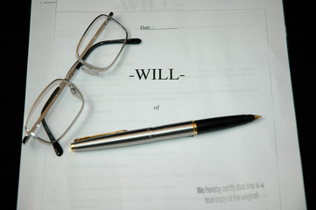
Wills
Outright gift of Residue
- CGT uplift on death
- Business Relief / Agricultural Relief
- 10% to Charity reduces IHT rate 40% to 36%
Business and Agricultural Property Legacy
Life interest – income only or flexible
- care fee planning
Discretionary Trust
- development land / disputes
Nil Rate Band Trusts (pre 2006 Wills)
Partnership / Shareholder Agreement
- may have an automatic or option to buy
- if not exercised – Agreements to permit share to be left by Will

Slide 15
Questions

Slide 16
